Slide 1

ATAX Problem Optimization
Assignment 1 – Team 5
Davide Buchignani – Francesco Caligiuri - Luca Di Leo – Salvatore Di Lorenzo

Slide 2
ATAX
The process of ATAX involves the multiplication of the matrix A, its transpose, and the vector x. This operation is fundamental in linear algebra for various computational tasks.
INCOLLARE FORMULA

Slide 3
We tried to implement:
Parallel For
Parallel For + Reduction
Parallel For + Collapse
Task
Accelerator Model

Slide 4
Code
Tre codici a confronto

Slide 5
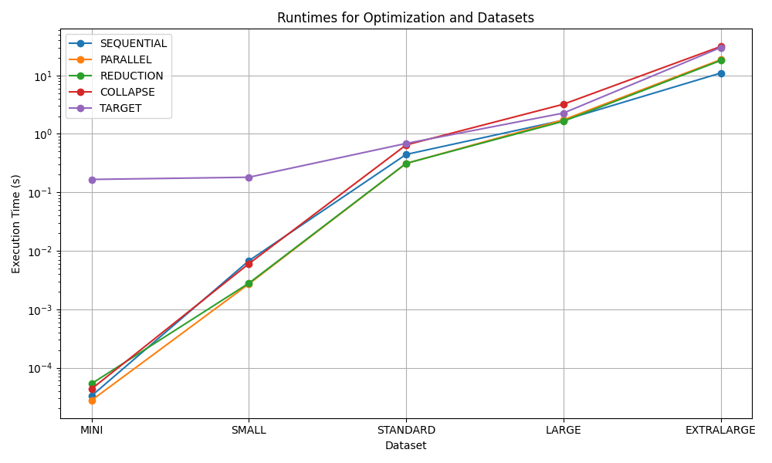
RESULTS COMPARISON

Slide 6
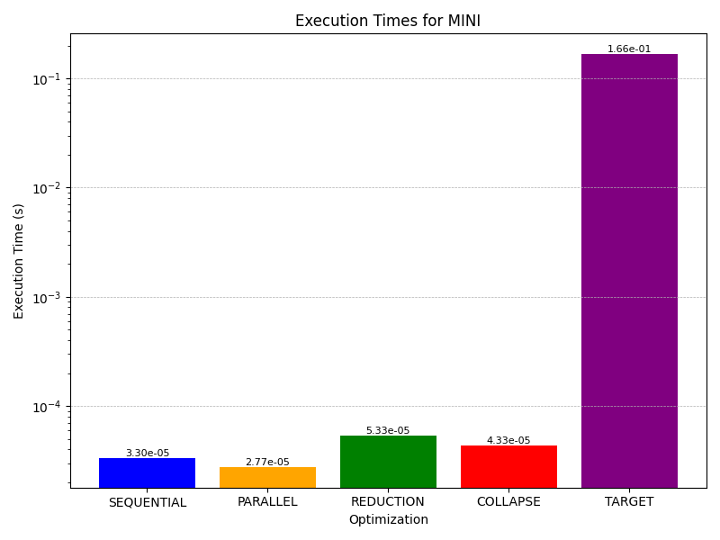
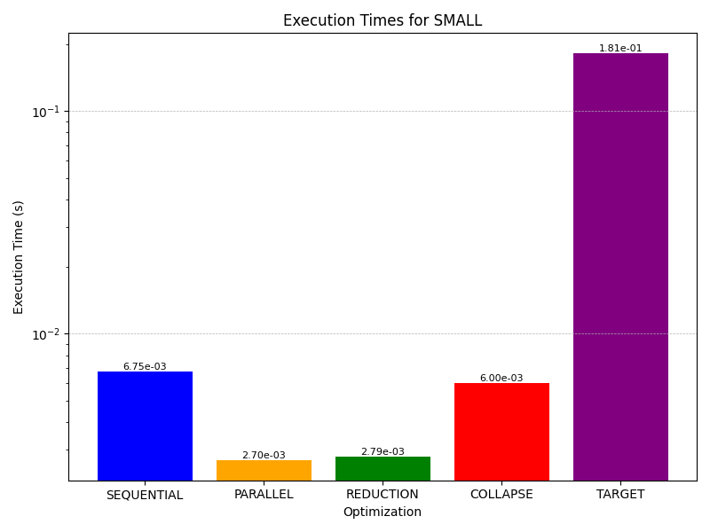

Slide 7
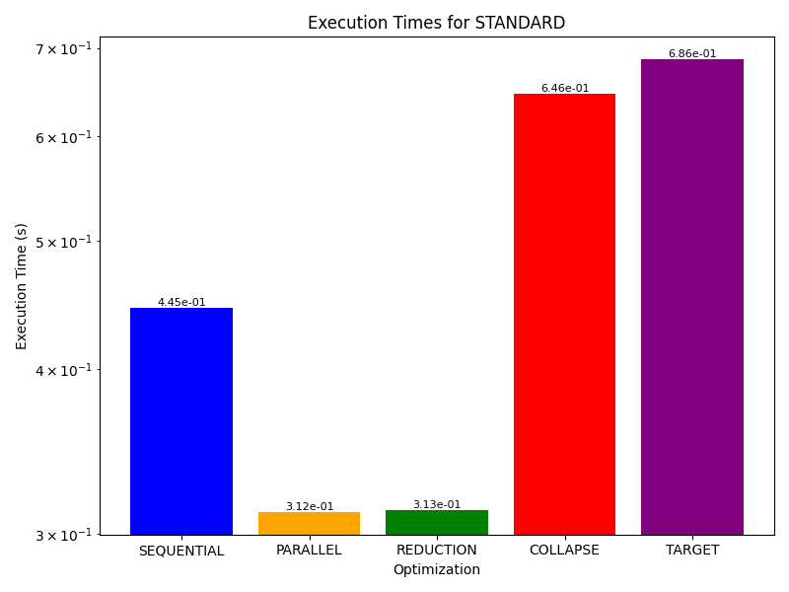
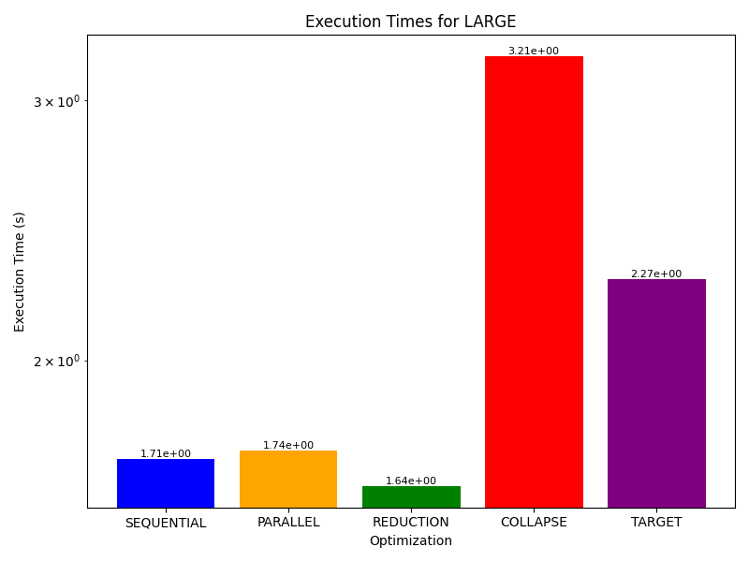

Slide 8
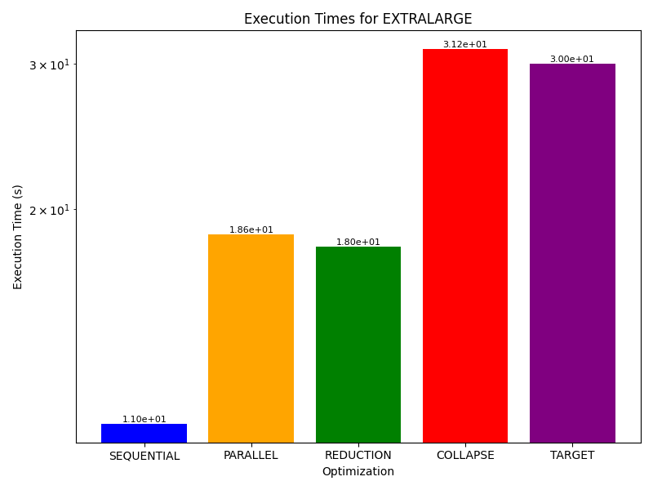


Slide 9
Conclusions
Why?
Parallel For + Collapse
Task
Accelerator Model

